Slide 1
Azure Stack HCI The best infrastructure for hybrid and datacenter modernization
Date
Notes:
This presentation provides the latest information on Azure Stack HCI as of March 2022.

Slide 2
Agenda
Microsoft hybrid approach
Why use hyperconverged infrastructure
What is Azure Stack HCI and what it’s used for
Azure integration and making it hybrid
Azure Kubernetes Service on Azure Stack HCI
Examples of new Azure Stack HCI features since GA
Customer momentum, use cases, and evidence
Hardware form factors-partner ecosystem
Licensing and how to buy Azure Stack HCI
Summary
Learning Paths
Resources

Slide 3



Innovation anywhere with Azure
Hybrid and multicloud
Azure
Single control plane with Azure Arc
Bring Azure services to any infrastructure
Modernize datacenters with Azure Stack HCI
Extend to the edge with Azure IoT
Notes:
Overview of Hybrid and multicloud offerings from Microsoft emphasizing breadth and technology scenarios.

Slide 4
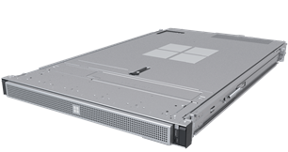
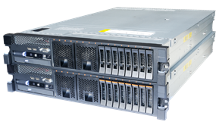
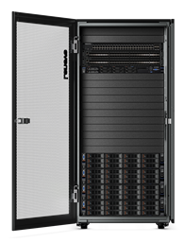
Modernize datacenters with Azure Stack
Azure Stack HCI
Hyperconverged solution
Azure Stack Edge
Cloud-managed appliance
Compute, AI & IoT
at the edge
Scalable virtualization and storage
Remote/branch office
High-performance workloads
Native integration with Azure Arc
AKS on Azure Stack HCI
Azure Stack Hub
Cloud-native integrated system
Disconnected scenarios
Notes:
Azure Stack family

Slide 5


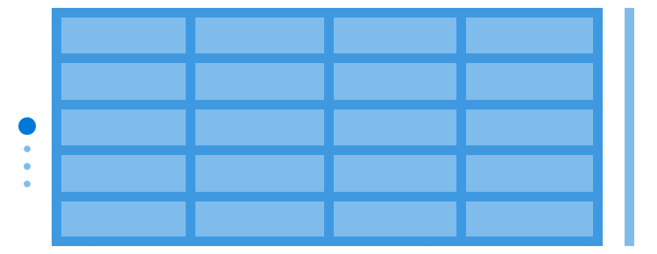
What is hyperconvergence?
Legacy “three tier” infrastructure
Ethernet switches
NETWORK
Misc. appliances
Hyperconverged infrastructure (HCI)
COMPUTE
Ethernet switches
Hypervisors
NETWORK
COMPUTE
STORAGE
Standard x86 servers
+
Local drives
+
The magic of software
NETWORK
COMPUTE
STORAGE
NETWORK
COMPUTE
STORAGE
Storage fabric
STORAGE
NETWORK
COMPUTE
STORAGE
Storage (SAN)
HCI is a software-defined, unified system that combines all the disparate and siloed elements of a traditional datacenter
Notes:
Hyperconvergence relies on software defined storage and networking to enable aggregation of all server resources into a virtual pool that can be accessed directly from any of the servers in the cluster. Hyperconvergence eliminates the need for SAN, storage switches and network appliances. Customers are left with servers and their internal disks, ethernet switches. Hyperconvergence reduces physical footprint, reduces the power and cooling requirements and greatly simplifies management.

Slide 6
Hyperconverged Market Size
The total HCI Market is currently growing at ~9% YoY and is expected to be $13.5B by 2023
~300+
New Azure Stack HCI solutions in the catalog
25+
HCI solution partners
~$2.7B
5 use case scenarios
Branch office and edge
Virtual desktop infrastructure
High performance SQL Server
Trusted enterprise virtualization
Tightly integrated Kubernetes
~70%
Customers deploying HCI on new HW
Top 5 geos usage share
USA | WE | JAPAN | UK | GERMANY
HCI SOFTWARE TAM
Source:
IDC Converged Infrastructure Tracker Q1-2020
Technology Business research (TBR) 2H19
Microsoft Windows Server Telemetry Q2 FY2020
Notes:
Overview of the market size and partner opportunity?
We can see that the Hyper Converged Infrastructure Market opportunity size is approximately ~$13.5B and the Software TAM around ~$2.7B by CY2023 and growing at ~9% YoY. We have identified 5 customer use case scenarios that will help frame the opportunity with OEM Hardware solutions from more than 25 partners and over 150+ Validated solutions in the new Azure Stack HCI catalog launching later this year. Some of those use case scenarios address things like Modernizing foundational infrastructure, Providing efficiency on IT infrastructure recourses, Benefits of low latency on heavy workloads such as SQL and Scale your resources in a simple and predictable way.
what's fueling that opportunity?
With Azure Stack HCI we see that the customer drivers are those that are retiring aging servers with the need to reduce cost with faster ROI. Today we have millions of customers still running EOS environments such as Windows Server 2008 that leads to large EOS upgrade opportunity. We have millions of servers on Hyper-V, which extends naturally to HCI, we see additional hero motion opportunities such as selling the HCI HOST OS along with your Windows Server GUEST OS to ensure that those customers that are running Windows Server-based applications on-prem is licensed correctly and future proof your customers investments with Azure Hybrid capabilities.
Hybrid is a Mainstream motion, and some recent analyst reports it indicates that 74% of enterprises are operating a Hybrid cloud and 75% of global organizations will be running containerized apps in production by 2022. ~70% of customers will deploy HCI on net new HW
The goal here is to Meet customers “where they are”..
1) Modernizing Infrastructure on prem as a click stop to cloud
2) Achieving operational efficiency by leverage cloud control planes
3) Refactoring applications to drive new business value and containerizing and making it portable those applications as they move cloud native
4) Gaining transformative insights from data and AI-enabled applications
Partner eco-system capturing HCI opportunities?
There is a couple of ways we see partners participating the selling of Azure Stack HCI either through Enterprise Agreement known as EA or our Cloud Solution Provider Program known as CSP and by being a direct or indirect provider for example:
Device partners including OEM-leveraging their direct sale force and hardware capabilities
(Value Added Resellers) VARs-leveraging their role of trusted advisors in new customer prospects
Distributors leveraging their hardware partners distribution network
ISV-ensuring the new HCI platform is compatible with key ISVs offering to simplify decision process for prospective customers
SI/CSP-helping with deployment and cloud services addition, influence customer decision on HCI platform

Slide 7
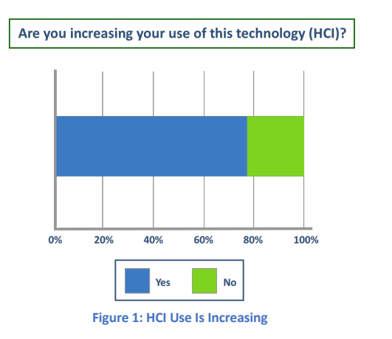
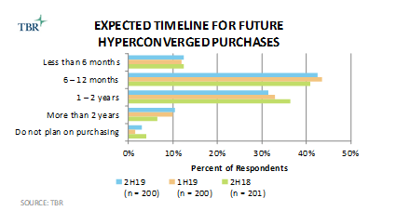
Usage of HCI technology keeps expanding
Majority of customers surveyed are planning to buy new HCI in the next year
Source: TBR-HCI Platforms and Customers Research 2019
Source: Evaluator Group-CI and HCI in Enterprise 2019
Notes:
This data from various sources is showing that acquisition of hyperconvergence is still high on the list. This particular data is from “late” 2019 but that trend has not slowed down yet.

Slide 8
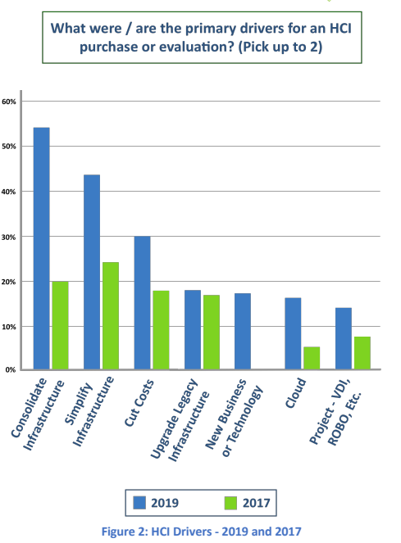
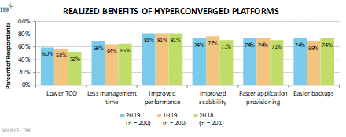
Reasons to use Hyperconverged Infrastructure
Optimized infrastructure costs
Simpler management
Good performance for multiple workloads
Source: TBR-HCI Platforms and Customers Research 2019
Source: Evaluator Group-CI and HCI in Enterprise 2019
Notes:
Optimized infrastructure costs
Solutions are based on industry standard hardware
Merge compute and storage in one
Only need to pay for what you use, scale as your needs grow by adding node
Smaller, more efficient IT staff
Simpler management
Reduce number of manual processes
No need for siloed expertise
Combined resources enables central management with more intuitive tools
Good performance for multiple workloads
Mix of flash/ spinning disks bring good performance for sequential and random workloads
Easy to scale by adding node(s)

Slide 9
Azure Stack HCI What is it and what is it used for?

Slide 10




Growing Azure Stack HCI into its own product line
Azure Stack HCI
Windows Server
Exciting roadmap of new HCI focused releases
Exciting roadmap of new releases
Innovation focused on being the
best virtualization host
Innovation focused on being the
best guest and traditional server
Future of Hyper-V virtualization,
software-defined storage and networking
All other Windows Server roles,
like IIS, File Services, DNS, DHCP, AD/DS
Run apps inside Windows or Linux virtual machines
Runtime for Windows apps like SQL Server
Runs on your hardware
Runs anywhere
Notes:
This slide positions the crossroad we are at. Azure Stack HCI for HCI, Windows Server for guest OS and traditional server role.
A key talking point is that “now” is the time when the differentiation between the 2 OS is at the smallest it will ever be. Since Azure Stack HCI is subscription based, it keeps accruing new features and value for HCI that will not be in Windows Server.

Slide 11




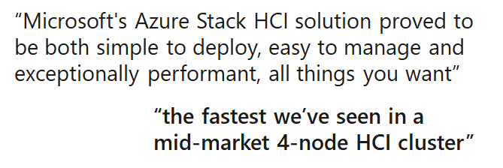
Azure Stack HCI Awards New feature update brings new awards
https://www.storagereview.com/review/dataon-azs-6224-azure-stack-hci-review
crn.com/techinnovators
Special thank you to DataON for sharing StorageReview testing
Notes:
To presenter: The slide is in this position to educate on the strength of Azure Stack HCI and to set the context to explain the innovation in Azure Stack HCI which appears in the following slides.

Slide 12
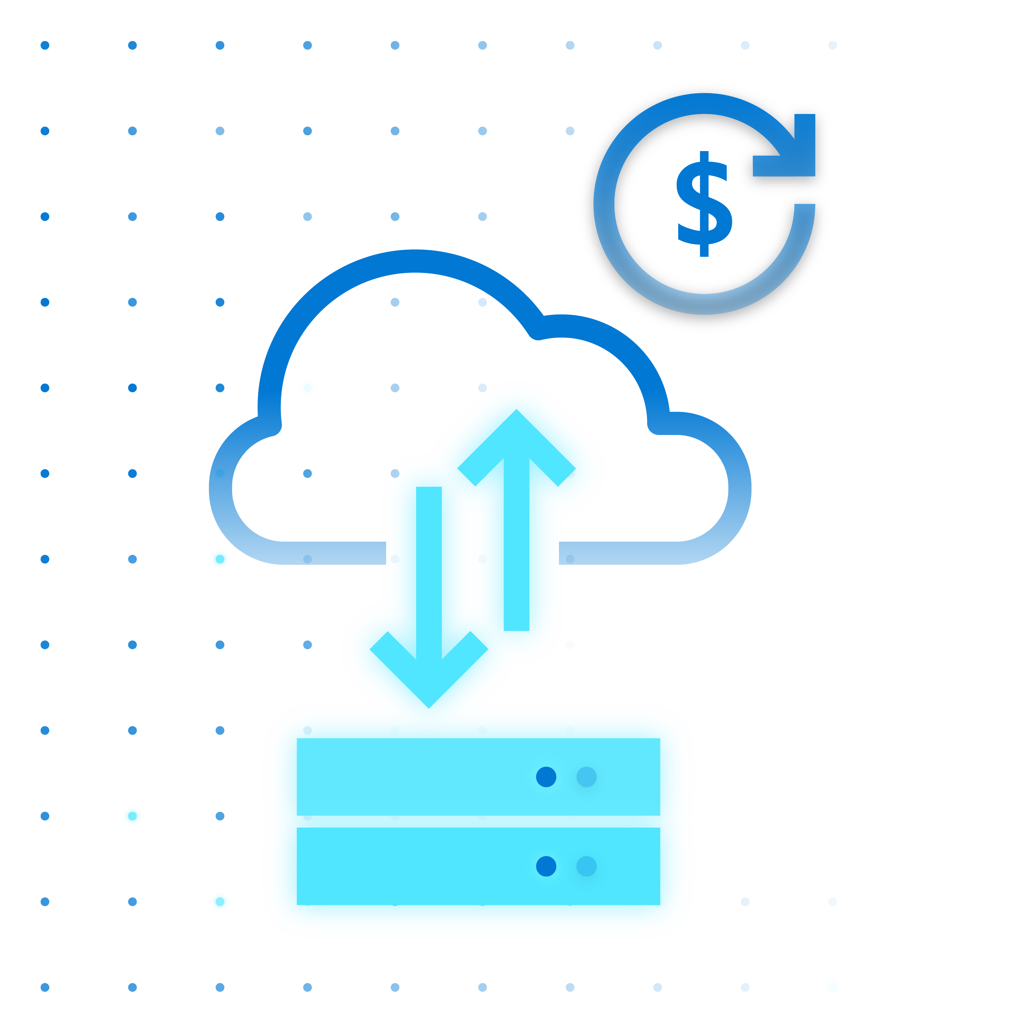



Azure Stack HCI
Modern subscription for flexible, familiar hyperconverged infrastructure
Azure hybrid by design
Enterprise scale and price performance
Familiar management and operations
Choice of deployment options
Notes:
Azure Stack HCI focuses on 4 pillars that brings value to customers:
-Hybrid by design and delivered as an Azure subscription
-Provide best in class scale and performance for virtualization
-It integrates will all familiar tools
-It has flexible deployment options

Slide 13
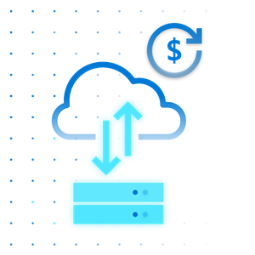
Azure hybrid by design
Azure hybrid by design
Native integration with Azure Arc and Azure Monitor
Connect to hybrid services like Microsoft Defender for Cloud, Azure Backup, and Azure Site Recovery
Monitor and manage clusters at scale from Azure
Centrally manage VMs from Azure portal
Fleet management for hosts and VMs
Always up to date HCI as a service ​
Regular and consistent feature and security updates
Unified Azure billing
Leverage existing Azure support plan

Slide 14

Enterprise scale & price-performance
Industry leading price-performance
Millions of IOPs and batch requests with Storage Spaces Direct
Optimized for SQL Server virtual workloads
Per physical core monthly subscription to scale up or down
Secure virtualization platform for Windows and Linux
Unlimited hosting of Linux VMs
Choice of licenses available for Windows VMs
Secured-core server supported for ultimate enterprise security
Includes Extended Security Updates (ESU) for Windows Server and SQL Server 2008/2012 R2
Built-in HA/DR
New simple deployment GUI for clusters available through Windows Admin Center
Stretch cluster: extend HCI cluster from a single site to two sites
Protect VMs with cloud backup

Slide 15

Familiar management and operations
Leverage existing skills
Built on foundation of Windows Server and Hyper-V
Familiar tools like Windows Server Admin Center and Azure portal
Support for Active Directory, Group Policy Object
Work with popular tools
Work with familiar Microsoft tools such as System Center and Windows Admin Center
Compatible with popular third-party tools such as Altaro, Datadog, Commvault, Veeam, and Veritas to name a few.
Benefit from automation
Management tasks are completely scriptable using popular, cross-platform Windows PowerShell framework

Slide 16
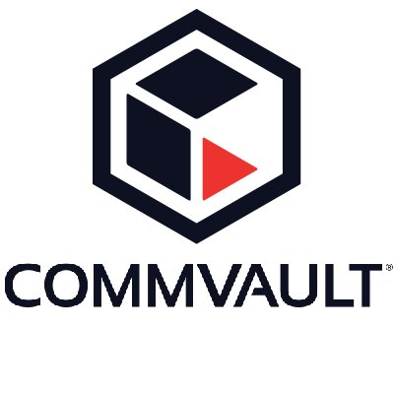





Examples of tools your team already knows
Altaro VM Backup
Commvault Backup & Recovery
Monitoring
Veeam Backup & Replication
Comprehensive Data Protection
System Center
Windows Admin Center
Windows PowerShell
Learn more at aka.ms/azurestackhci-utilityapplications
Notes:
We know how important and valuable it is for IT to standardize on tools and processes they can apply across their entire estate, to all the infrastructure they manage. That’s why we believe that to modernize and use Azure Stack HCI, you shouldn’t need to change the way you operate, you shouldn’t throw out the skills your team already has.
The key point is that: you’re the administrator, you’re in control, and you decide the tools you need.

Slide 17

Choice of deployment options
Choice of Validated Nodes or Integrated Systems
Validated nodes based on standardized reference architecture
Available Integrated Systems for fastest time to value: pre-installed software and integrated drivers and firmware
Extensive choice of hardware partners
Choose your preferred vendor for local support and delivery
Flexible sizing available from small to rack class options
Possible to use existing hardware
Check with your OEM or solution provider to ensure you are running a validated solution. In certain cases, you may be able to re-use existing hardware.

Slide 18
Azure Stack HCI hardware deployment scenarios
Recommended for fastest time to value
Leading hardware vendors offer integrated systems
Simple to deploy and procure
New full stack update feature in Azure Stack HCI and Windows Admin Center makes upgrades, maintenance and management super easy for customers
Ideal for customers who require turn-key solutions with little deployment effort from IT staff
Joint support agreement with partners with ticket exchange between partner and Microsoft
“Fully integrated” appliance-like experience
Azure Stack HCI
Integrated Systems
Broadest choice of hardware components
More diverse configurations for demanding workloads, some customization due to diversity of solution offerings
Ability for customer to engage with preferred SI for deployment and integration if needed
Existing hardware can be repurposed as long as it matches a current validated node solution in the Azure Stack HCI catalog
Separate support for hardware and software
Historically, validated nodes are the most popular hardware scenario
Azure Stack HCI
Validated Nodes
Reference architecture “like”
Azure Stack HCI Validated Nodes
On new hardware
- OR -
Check with your OEM or solution provider to ensure you are running a validated solution. In certain cases, you may be able to re-use existing hardware.
1. On new hardware
2. Reuse existing hardware if it matches a configuration in the Azure Stack HCI Catalog
Visit the Azure Stack HCI Catalog to find the validated hardware offerings from our global partners​
Notes:
Azure Stack HCI hardware deployment scenario overview.
The fastest time to value is to use an integrated system which comes to the customers with an “appliance like” experience and also provides integrated support. It represents a smaller portion of deployments.
The largest part of deployments is through validated nodes which are akin to a “reference architecture’ and has more flexibility in component choices. Historically these make up the largest part of HCI deployments.

Slide 19

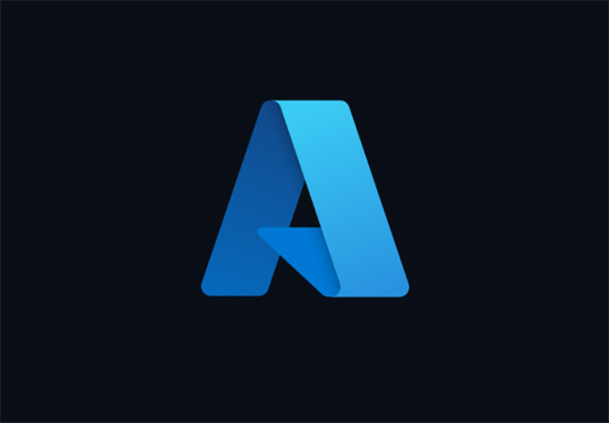



Details on two deployment options
Integrated Systems: Solution with services, software, subscription (fewer steps)
1
Get integrated Systems
( Azure Stack HCI OS+ Hardware + Software)
2
Set it up using WAC and OEM Plug-in
( Newest OS updates, firmware and Drivers )
3
Get Azure
Order solution from OEM or distributor
Deployment services to help rack and stack
Download and install Admin Center
Create cluster (integrated workflow) ¹
Sign-up for Azure ²
Register with Azure
Validated Nodes: Customer / SI builds the solution (more steps)
1
Get Azure
2
Get hardware
3
4
Set it up- with WAC and OEM WAC Plug-in (if available)
Get software
Create cluster in Wizards ¹
Register with Azure
Start at Azure.com/HCI
Sign-in to Azure
Choose hardware from catalog
Order, rack, and stack
Download and install Admin Center
Download and install HCI OS
4
Prepare – w/o OEM WAC Plug-in
5
Set it up- w/o OEM WAC Plug-in
Find Drivers and firmware from OEM or IHV
Create cluster in Wizards ¹
Register with Azure
¹ Integrated hardware/software deployment available for integrated systems, regardless of purchasing channel. ² Distributor or OEM can act as Cloud Solution Provider (CSP) to supply end-customer with Azure subscription, or not.

Slide 20


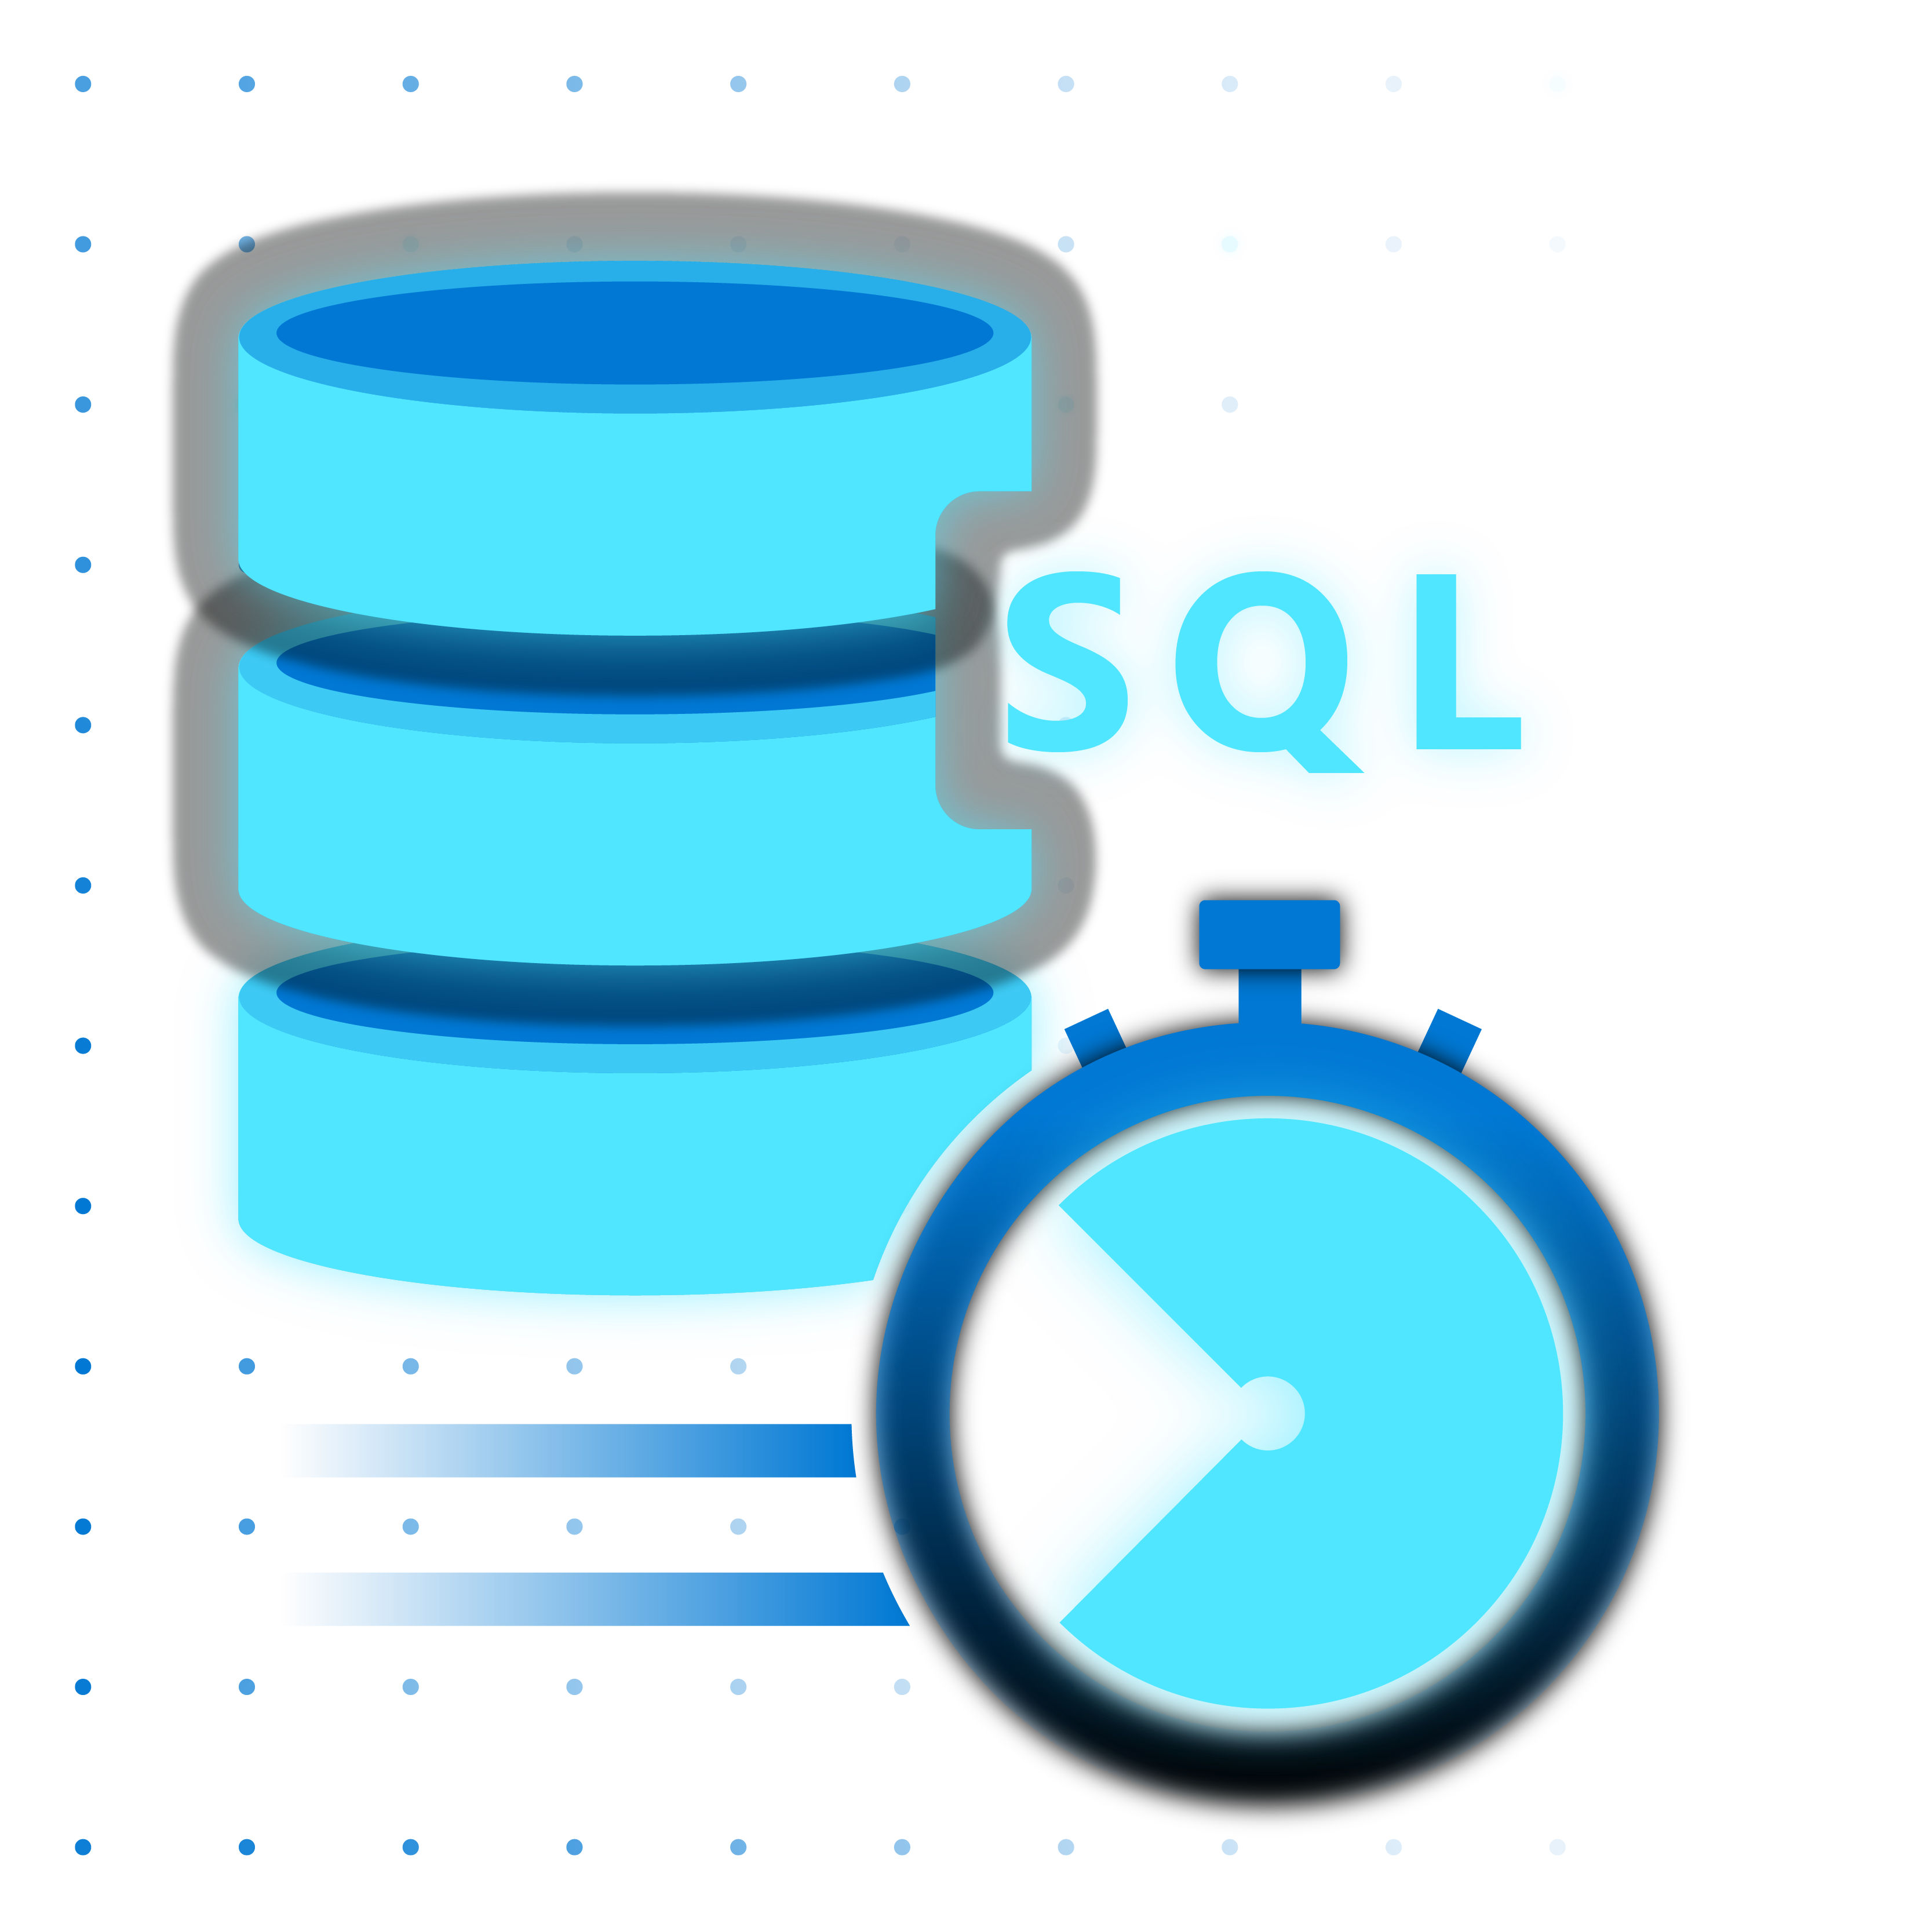

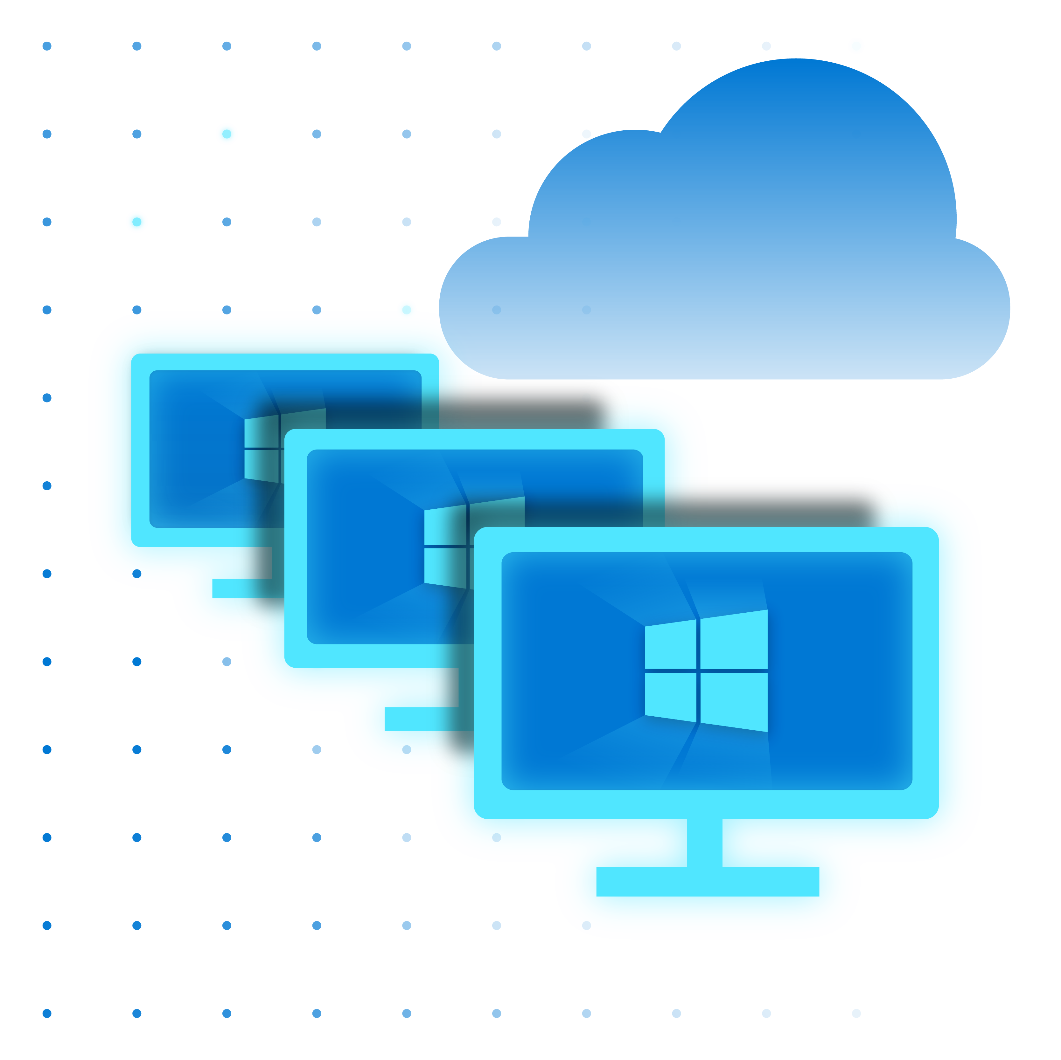



When to use Azure Stack HCI
Run virtual machines on-premises and easily connect to Azure hybrid services
Modernize and secure your retail infrastructure
Affordably run intelligent edge and remote branch retail solutions
Industry-best performance for SQL Server databases
Deploy cloud native apps and Azure Arc enabled services through tight integration with AKS on HCI
Best in class virtual desktop experience with Azure Virtual Desktop for Azure Stack HCI
Notes:
There are 5 use cases that we talk about for Azure Stack HCI
Use these slides to tell the customer the best scenarios for using Azure Stack HCI
1. Modernize and secure your datacenter – with enterprise secure virtualization
2. Affordably run intelligent edge and remote branch solutions by providing appropriate infrastructure for these types of environments by leveraging the low price per core and the switchless capability of Azure Stack HCI and a true 2 node deployment (competitor typically starts at 3)
3. Industry-best performance for SQL Server VM – demonstrated through TPC benchmarks. Microsoft owns end to end stack for SQL Server providing better optimization of SQL Server virtual workloads.
4. Deploy cloud native apps and Azure Arc enables services - using AKS on HCI provides the Kubernetes platform that customer can use to take cloud apps and run them as a container on Azure Stack HCI. It also enables the deployment of all Azure Arc enabled services.
5. Best in class virtual desktop experience with Azure Virtual Desktop (AVD) for Azure Stack HCI

Slide 21

Modernize and secure your datacenter
When to use Azure Stack HCI
Modernize foundation infrastructure
Bring requirement for trusted enterprise virtualization by providing a highly secure infrastructure for workloads through virtualization-based security (VBS)
Secured-core server supported for ultimate enterprise security
Benefit from no cost Extended Security Updates when migrating Windows Server and SQL Server 2008/2012 R2
Gain better efficiency and lower costs
Reduce server racks footprint and lower cooling and utility costs
Lower CAPEX by upgrading from legacy storage
Simplify governance
Reduce the elements that need to be managed and supported
Simplify operations with unified tools and a single point of support

Slide 22

Affordably run intelligent edge and remote branch solutions
When to use Azure Stack HCI
Provide efficient IT infrastructure resources
Bring efficient IT to remote locations at the right price by leveraging switchless deployment and true 2 node clusters if local failover is needed and a one-node offering when reducing space and Capex are priorities
Ensure high availability and storage resiliency
Even at your remote location, Storage Spaces Direct provides storage resiliency for 2 nodes
Leverage nested resiliency and cloud quorum technologies
Manage your distributed clusters from a “single pane of glass”
Leverage integration with Azure and Azure Arc enablement

Slide 23
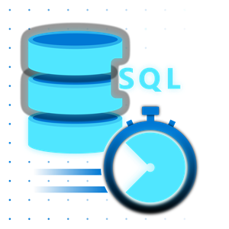
Industry-best performance for SQL Server databases (in VMs)
When to use Azure Stack HCI
Millions of storage IOPS and database transactions possible
Leverage the kernel embedded architecture to ensure great performance for demanding SQL Server based applications
Fastest HCI industry benchmark for virtual SQL Server workloads on a 4-node cluster
Benefit from very low latency
Azure Stack HCI supports NVMe, RDMA and persistent memory
Accelerate Azure Data Services and Big Data clusters at the edge

Slide 24
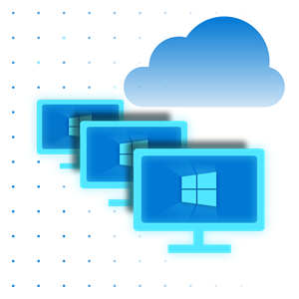
Deploy cloud native apps and Azure Arc enabled services leveraging AKS on HCI
When to use Azure Stack HCI
Bring a container managed platform to your on-prem environment enabling running PaaS like service on-prem
Deploy cloud native apps in AKS such as cognitive services and deploy unmodified to the edge
With built-in resiliency, ideal platform to run Azure Arc enabled services like data services

Slide 25
Best in class virtual desktop experience with Azure Virtual Desktop for Azure Stack HCI
When to use Azure Stack HCI
Extend the benefits of cloud-managed VDI to on-premises to meet unique performance and data locality requirements
The only VDI solution with full Windows 10 or 11 multi-session support for cost optimization
End-user access from virtually anywhere

Slide 26
Azure integration and making it hybrid

Slide 27
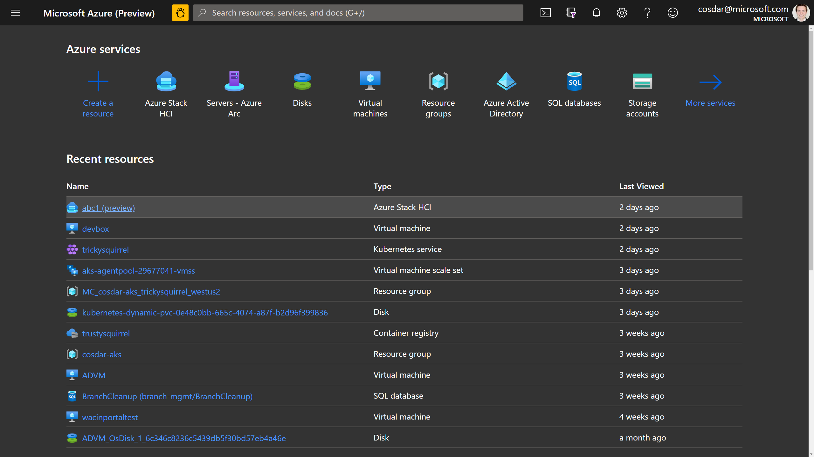



Simplify hybrid with native Azure integration
Azure Resource Manager (ARM) resource represents each on-premises Azure Stack HCI cluster
Visibility in the Azure Portal and foundation for hybrid management
No fuss with agents or scripts – it’s built-in!
Azure Active Directory
Subscription
Azure Stack HCI
Resource Provider
by Microsoft
Resource Group
NEW
Resource for
Azure Stack HCI
Azure Portal
Cloud
On-premises
Server 1
Server 2
Server 3
On-premises cluster
Notes:
When you finish setting up the new Azure Stack HCI, it natively integrates with Azure and the Azure Resource Manager (ARM).
There is no separate agent you need to download, install, and maintain; there’s no complicated script to fuss with. Instead, Azure Arc is built natively into the operating system. Each on-premises cluster is projected into your Azure AAD tenant and subscription, as an Azure resource, so that you can see it in the Azure Portal.

Slide 28






Connect seamlessly with Azure when using Windows Admin Center
Azure Site Recovery
Azure Backup
Azure File Sync
Azure Update Management
Azure Monitor
Microsoft Defender for Cloud
Notes:
These are services that can easily be added to Azure Stack HCI clusters though one click add on in WAC.

Slide 29
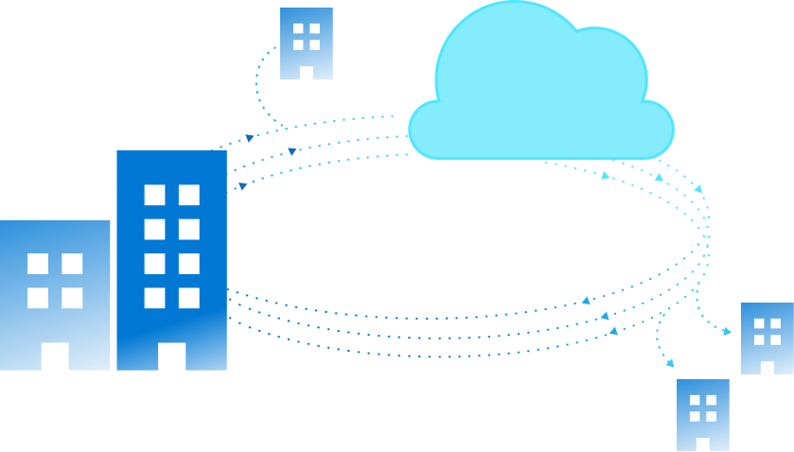
How do customers use hybrid?
Extend on-premises into Azure
Offsite backup and disaster recovery
Extend on-premises capacity
Centrally manage from Azure
Centralized update management
Cloud-based monitoring
Security and advanced threat protection
Centralized governance across environment

Slide 30





Azure Stack HCI & hybrid via Windows Admin Center
Azure Stack HCI host
Guest VMs
Extend on-premises into Azure
Offsite backup and disaster recovery
Extend on-premises capacity
Azure Site Recovery
Azure Backup
1 0 0 1
Cloud Witness
Azure File Sync
Centrally manage from Azure
Centralized update management
Cloud-based monitoring
Security and advanced threat protection
Centralized governance across environment
Microsoft Defender for Cloud
Azure Monitor
Azure Update Management
Notes:
How to bring value not only to the HCI OS but also the guests VMs showing one of the value of Hybrid.

Slide 31
Azure Kubernetes Service on Azure Stack HCI AKS on HCI

Slide 32
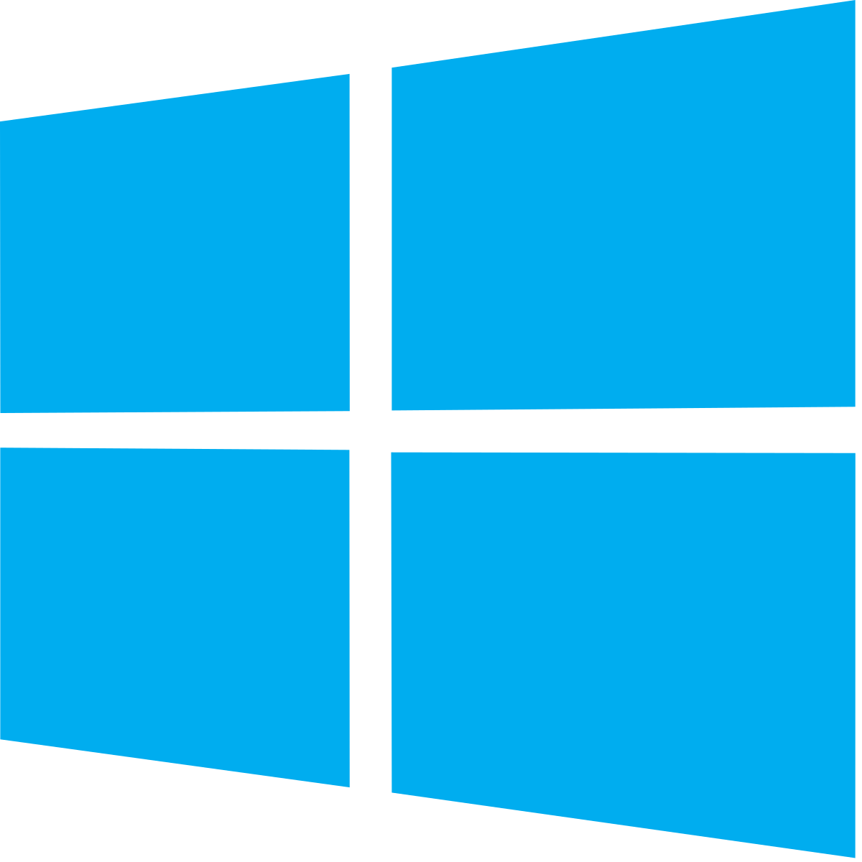

AKS on Azure Stack HCI
Familiar Kubernetes application platform available on Azure Stack HCI
+
+
Azure hybrid by design
Best platform for .NET apps on-premises
Built-in security
AKS-consistent Kubernetes cluster management
Easy AKS deployment on Azure Stack HCI
Built-in Azure Arc capability
Support for both Linux and Windows applications
Differentiated container solution for Windows
Local administration with Windows Admin Center
Secure and trusted platform
Single and consistent identity
Always up-to-date like Azure
Notes:
This is the equivalent “what is” slide for AKS on HCI. We focus on 3 points:
-Hybrid by design….same experience as AKS but available on-prem
-really shine with .Net app
-Great security built-in on a trusted platform

Slide 33
Azure hybrid by design
AKS-consistent Kubernetes cluster management
Centrally managed from Azure portal
Fleet management for Kubernetes platform and containers
Easy AKS deployment on Azure Stack HCI
“Single”-step installation and update of a fully-conformant Kubernetes cluster
Built-in logging, monitoring, load-balancing, and certificate management
Built-in Azure Arc capability
Easily bring Azure services on-premises with Azure Arc
Consistent identity and security
Notes:
Talking points on the slide

Slide 34

Best platform for .NET apps on-premises
Built-in support for both Linux and Windows
All-inclusive and fully-supported infra-ready to run Windows and Linux containers out-of-the-box
Single vendor support leading to faster turnaround on support and fixes
Differentiated container solution for Windows
Domain credentials in containers with gMSA v2
AD and Azure AD integration​
Local administration with Windows Admin Center
Windows Admin Center and PowerShell for the Windows experts
Integrated Windows app migration tooling

Slide 35

Built-in security
Secure and trusted platform
Secure endpoints and Kubernetes clusters with Azure Active Directory, Microsoft Defender for Cloud, and Azure Sentinel
Runtime protection to defend the K8S platform from attacks and vulnerabilities
Single and consistent identity
Security updates for all components, including OSS
Certificate Authority for secure intra-cluster communication ​
Always up-to-date like Azure
Regular and consistent feature and security updates
Unified Azure billing
Leverage existing Azure support plan
Notes:
Talking points on the slide

Slide 36

When to use AKS on Azure Stack HCI
Run Kubernetes on Azure Stack HCI and easily connect to Azure services
+
+
AKS applications on Azure Stack HCI
Develop in AKS but deploy unmodified to the edge
Modernize Windows and Linux apps
.Net framework and core apps being containerized
Data Services on Azure Stack HCI
Run Azure Arc for Data Services on a resilient platform
Notes:
3 key use cases for AKS on Azure Stack HCI:
-Bring cloud native app on prem with AKS on HCI essentially PaaS on-prem
-Providing modern container management for Linux and Windows container
-Provide a platform to deploy any of the Azure Arc services who rely on K8. AKS on HCI with HCI provides a resilient and fully integrated platform to deploy all of these services.

Slide 37


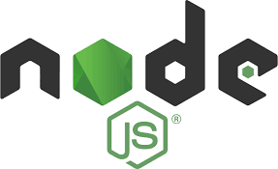
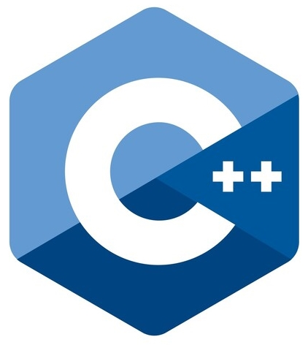










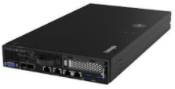
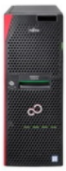
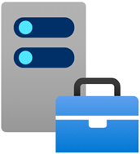
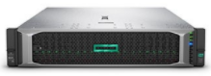
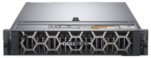
Azure Stack HCI hybrid all up
Hybrid Services
Azure Arc
For cloud management
Site Recovery
Applications
Backup
Azure Portal
Update Management
Windows
Linux
Containers
Cognitive
Services
Data
Services
Azure Arc
File Sync
Virtual machines
Any size and configuration
Azure Kubernetes Service
Managed container platform
Monitor
Azure Stack HCI
Hyperconverged infrastructure software stack
Microsoft Defender for Cloud
Hardware ecosystem
300+ solutions, validated by Microsoft
Windows Admin Center
Edge-local management
Notes:
Customers can realize the all up value of a well integrated platform. VMs are shown in white, containers in purple. With that infrastructure, customers can run cloud native apps on prem (shown in white at the top layer). Additionally, customers can manage locally with WAC or through the Azure portal with the built-in Arc integration.

Slide 38
Azure Stack HCI new features since GA

Slide 39






Examples of new features since GA
Automatic Virtual Machine Activation (AVMA)
Secured-core server
Multi-cluster monitoring
New Azure regions available
Preview Channel
Notes:
AVMA
Simplify licensing with Automatic Virtual Machine Activation (AVMA)
Enter unused Windows Server 2019 Datacenter key into Azure Stack HCI host
Not available on any other hyperconverged infrastructure
Watch the AVMA video walkthrough https://youtu.be/wdvtZt3-UQ0
Secured-core server
This new security feature requires integration of silicon vendor and OEMs. It provides comprehensive security at all physical layers (details on the slide). Support for Secured-core server will be mandatory for Integrated System for Azure Stack HCI with 21H2.
Multi-cluster monitoring
This is the feature that essentially enables “one pane of glass”. It enables customers to monitor and manage their cluster from a central location: Azure portal. It is an especially useful features for customers who have Azure Stack HCI in many locations like retail/manufacturing. Video walkthrough https://www.youtube.com/watch?v=mcgmAsNricw
New Azure regions available
we are expanding where the subscription is available around the world. Note that you can run Azure Stack HCI even if it is not in a local Azure datacenter.
Preview Channel
This is a new feature that lets customers “see” what upcoming next in their subscription. This helps customers better plan their deployment

Slide 40


Benefits from convenient inherited activation
Windows Server
Simplify licensing with Automatic Virtual Machine Activation (AVMA)
Enter unused Windows Server key into Azure Stack HCI host
Not available on any other hyperconverged infrastructure
Watch the AVMA video walkthrough
Azure Stack HCI

Slide 41
Secured-core server
Secure hardware, firmware and OS capabilities to help protect against threats
Simplified security
Server OEMs develop systems with certified built-in security
Collaboration across Microsoft, silicon and OEM partners to simplify security enablement
Windows Admin Center user experience provides easy access to configure the state of the Secured-core features
Advanced protection
Defense-in-depth protection over multiple layers across hardware, firmware and OS
Security from silicon-up with Windows Defender System Guard providing system integrity against firmware attack
Virtualization-based security (VBS) isolates critical parts of the system from even privileged malware
Preventative defense
Disrupt practical attack vectors proactively
VBS features like HVCI and Credential Guard prevent entire classes of vulnerabilities and better protect sensitive assets like credentials
Trusted Platform Module 2.0 (TPM 2.0) provides hardware root-of-trust as a secure foundation
Notes:
This new security feature requires integration of silicon vendor and OEMs. It provides comprehensive security at all physical layers (details on the slide). Support for Secured-core server will be mandatory for Integrated System for Azure Stack HCI with 21H2.

Slide 42


Multi-Cluster Monitoring
Azure Monitor Workbooks
Managed by Azure
Provides at scale perspective
Customizable and collaborative
Azure Log Analytics Workspace
Cloud
On-premises
Periodic Event Logging
MMA
MMA
MMA
MMA
Arc
Arc
Arc
Arc
HCI OS
HCI OS
HCI OS
HCI OS
Azure Stack HCI cluster (Cluster-1)
Azure Stack HCI cluster (Cluster-2)
Notes:
This is the feature that essentially enables “one pane of glass”. It enables customers to monitor and manage their cluster from a central location: Azure portal. It is an especially useful features for customers who have Azure Stack HCI in many locations like retail/manufacturing.

Slide 43


Multi-Cluster HCI Monitoring Benefits
Managed By Azure
Highly Scalable
User Customizable
Always up-to-date
Can display up to 400+ clusters at a time across all your subscriptions
No dependency on Microsoft product team to add/remove/edit the visualizations and queries
It will be available in Azure Monitor Workbook Gallery and Insights hub
No boundary limitation on cluster, domain, and physical location
Freedom to add/remove windows event required for the visualizations
No database setup
No 3P software setup
Option for personal and shared workbook
Watch the video multi-cluster monitoring video walkthrough
Notes:
Benefits with talking point on the slide

Slide 44

Expanding to new Azure regions
Azure Stack HCI available today
East US (default)
Southeast Asia
West Europe
China East 2*
UK South
West Europe
Germany West Central
US Gov Virginia
East US
Japan East
China East 2
Newest Azure Stack HCI regions
Australia East
Brazil South
Germany West Central
Japan East
US Gov Virginia *
UK South
Southeast Asia
Brazil South
Australia East
* Sovereign clouds, see https://azure.microsoft.com/global-infrastructure/regions
Notes:
We are expanding where the subscription is available around the world. Note that you can run Azure Stack HCI even if it is not in a local Azure datacenter.

Slide 45
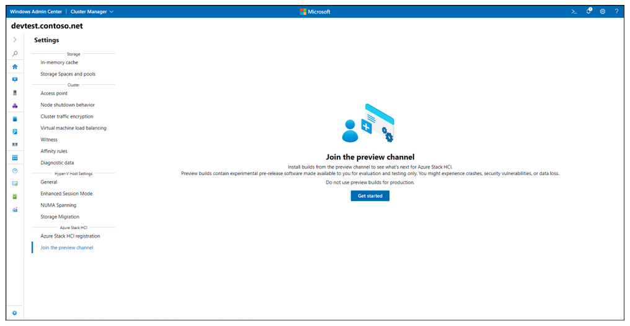
Azure Stack HCI Preview Channel
Introducing an all-new way to see what's next for Azure Stack HCI
Beginning with the June 2021 cumulative update, you can join a secondary (non-production) cluster to the Preview channel and start flighting.
Use Windows Admin Center or PowerShell to join the Preview channel
The Preview channel is for evaluation and testing only. You won’t get billed for Azure Stack HCI.
Docs: Azure Stack HCI preview channel >>
Notes:
This is a new feature that lets customers “see” what upcoming next in their subscription. This helps customers better plan their deployment.

Slide 46
Customer momentum, use cases, and evidence

Slide 47


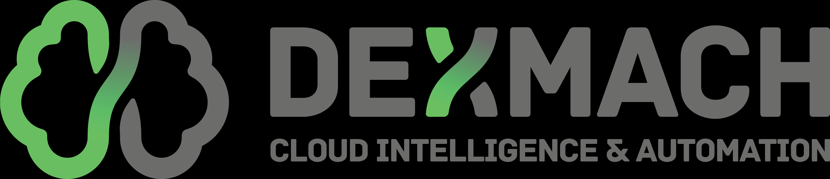
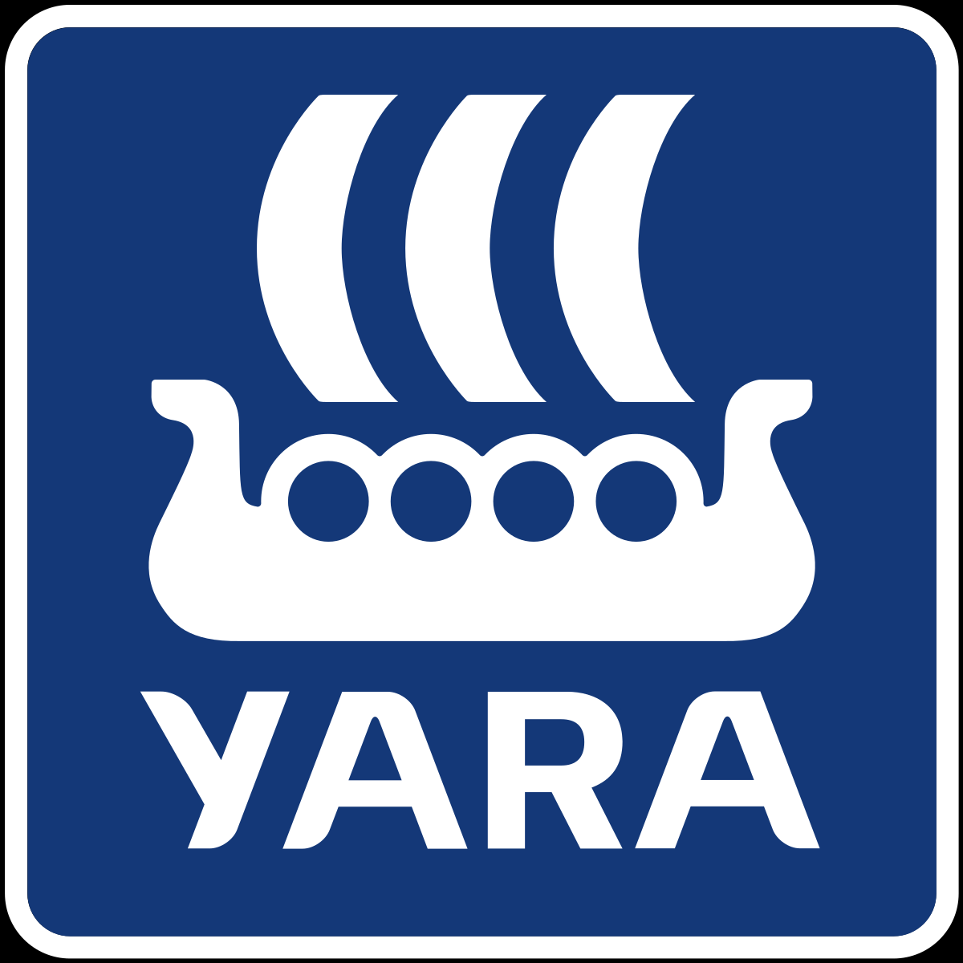


Azure Stack HCI customer momentum
“What amazed us is how well Azure Stack HCI just worked. Getting set up was straightforward and seamless, and we didn’t have to worry about any of the details.”
Andrew France, Systems Administrator and Technical IT Services Delivery Manager, Benenden School
“We wanted high-speed performance, not just reduced costs and a smaller physical footprint. Using Azure Stack HCI to accomplish those aims is a no-brainer.”
Paul Maune, Systems Architect, Bradley
Notes:
Various comments from customers

Slide 48
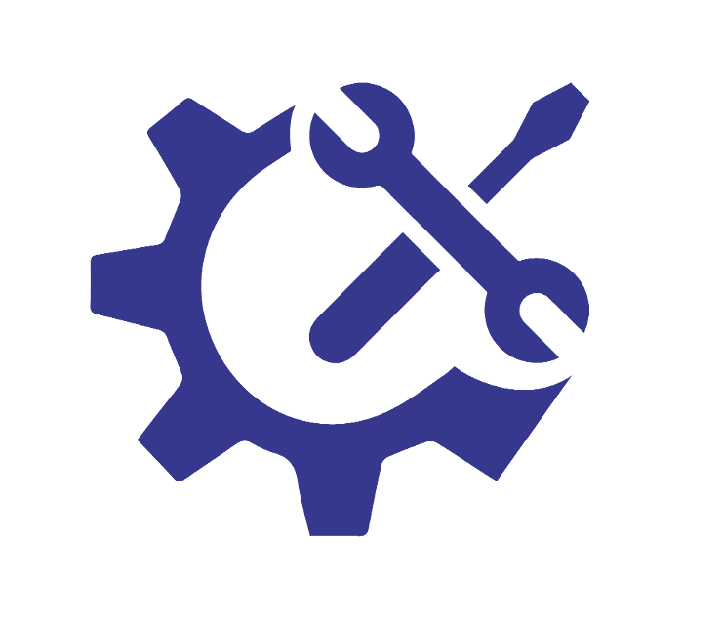


Azure Stack HCI: Datacenter modernization use cases
Real examples in three verticals
Technology services industry
Healthcare organization
Private education institution
Background: software developer internal IT to enabled build/production, billing and support systems
Workloads: build systems, developer support, customer-facing technical support, LOB apps and large file services
Needs: massive capacity and robust performance of customer-submitted “dump” files for reproduction and debugging
Plan: upgrade existing Hyper-V servers to Azure Stack HCI, expand cluster size and storage capacity, leverage Stretch Cluster between 2 datacenters for fault tolerance
Background: multi-hospital and clinic with Hyper-V and 3rd party disaggregated storage (migrated from VMware) and strong Azure push for some workloads
Workloads: EPIC, SQL and Oracle DBs, LOB apps, AD, VDI, a few Linux apps
Needs: hardware refresh, move to modern HCI model, leverage Azure investment to manage on-prem as direction
Plan: ramping on Azure Stack HCI storage feature knowledge in-house, looking for integrated systems with pre-installed HCI to modernize infrastructure
Background: one campus, 2 buildings, legacy iSCIS SAN, <100 VMs
Workloads: LOB apps primarily on Windows, file and collaboration services for students, and SC for management
Needs: refresh aging hardware and upgrade to modern HCI stack while leveraging their existing operational skills
Plan: replace SAN storage with Azure Stack HCI and add Stretch Cluster for automation of site resiliency, utilize Windows Admin Center to deploy HCI and Stretch Clustering
Notes:
This slide introduces the concept of verticals. These are real cases from our early adoption program. The use case here is data center modernization….customers upgrading their main data center to HCI.

Slide 49

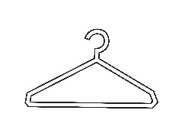

Azure Stack HCI: Branch office and edge use cases
Real examples in three verticals
Grocery retailer
Clothing retailer
Manufacturer
Background: legacy Hyper-V x 2 servers, not clustered, not hyperconverged, local storage only, hundreds of stores
Workloads: SC Configuration Manager DP, Print server, POS transactional software and database, inventory system, store control systems and IoT
Needs: resiliency/fault tolerance, hybrid model to attach cloud services, fleet management, platform to modernize applications (K8s)
Plan: migrate VMs to 2 node Azure Stack HCI cluster, improve perf/reliability, future proof, Azure billing simplicity
Background: VMware shop, no hybrid management, no clustering (too expensive), thousands of store locations
Workloads: POS system, theft deterrent system (video, proximity), discounting/coupon/reward systems
Needs: fault and latency tolerance, fleet management, modern POS support, delegation of operations functions, basic GPU functions for inferencing, basic IoT support
Plan: upgrade to modern, edge servers, right-size h/w core count to workload needs, 2 node Azure Stack HCI cluster, virtualize/containerize every function
Background: mix Nutanix (ESX) and Hyper-V shop, manufacturing and distribution centers around the US, 2 datacenters and ~30 “edge” sites
Workloads: Warehouse Management, ERP systems and other various LOB apps + infra: file/print and authentication
Needs: desire move to OPEX acquisition model and pay-for-use aligned to cloud migration, support for varied connectivity in some sites
Plan: replace SAN in DC with HCI and deploy 2 node clusters to edge, move to hybrid management to improve IT ops
Notes:
This use case is ROBO and showcases real customer scenarios from the Azure Stack HCI early adoption program.

Slide 50

Modernizing IT infrastructure
Business Need
The Dai-ichi Life Insurance Company, Limited wanted system infrastructure and next-generation server infrastructure for standardized operability and superior scalability. The company demanded a new, swiftly deployable framework that met requirements for on-premises provisioning speeds as fast as the cloud to leverage the unique advantages of on-premises and cloud-based platforms.
"Building stable system infrastructure used to require months of investigation and testing. Dell Technologies has an extensive lineup of validated Azure Stack HCI systems, listens to our challenges, and proactively suggests flawless solutions.”
Toshiki Ota Fellow Senior Executive IT Specialist IT Business Process Planning Dept. The Dai-ichi Life Insurance Company, Limited Dai-ichi Life Holdings, Inc.
Solution
Dai-ichi Life Insurance adopts Dell EMC Integrated System for Microsoft Azure Stack HCI (Dell EMC AX-740xd) and PowerProtect DD for its new platform as part of ongoing initiatives for IT infrastructure at the forefront of technology
Business Impact
Validated Azure Stack HCI hardware configurations dramatically reduce deployment testing work
New IT infrastructure that can quickly accommodate business and social changes
Server administrators can easily manage operations without needing specialized storage expertise
The time required for backup, which previously hindered nighttime maintenance, has halved
Notes:
Case study from one of the largest insurance company in Japan. This was a win provide by Dell.

Slide 51
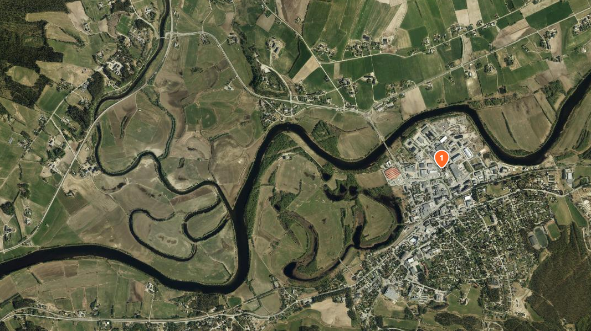


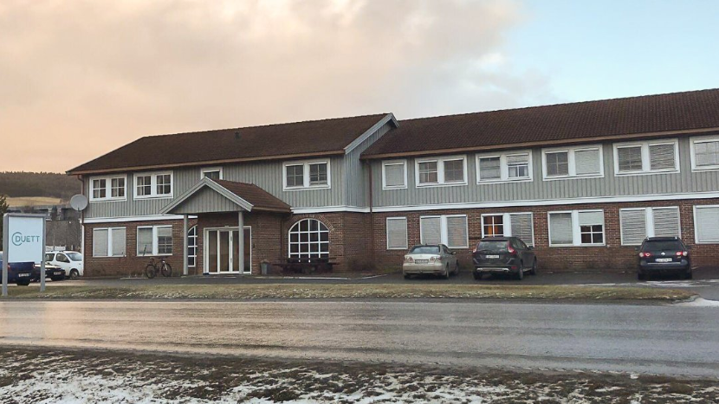

Case Study: Duett
Service provider in Tynset, Norway
Accounting solutions
Over 12,000 regional customers
Approx. 285,000 SQL Server databases
https://duett.no/
Notes:
This case study shows well how HCI can reduce footprint in a data center. This was provided by Lenovo.

Slide 52
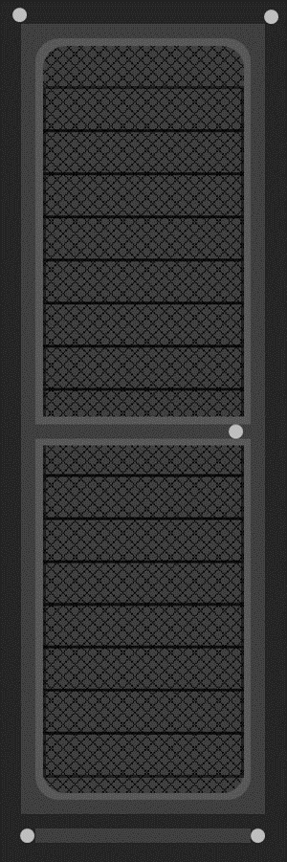
Datacenter footprint before…
8 RACKS
14 clusters • Windows Server 2012 R2 • SAN

Slide 53
Datacenter footprint with Azure Stack HCI
3 RACKS
3 clusters • 11 × Nodes per cluster • Intel® Optane™ P4800X

Slide 54
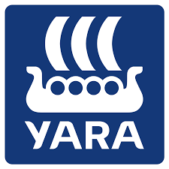


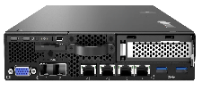
Azure Stack HCI for manufacturing and remote sites
Customer Case: Yara International
Yara addresses global challenges and create positive change as the world’s leading fertilizer company and a provider of environmental solutions to protect the world’s resources and the environment.
Lenovo ThinkAgile MX Integrated Systems
The Lenovo ThinkAgile MX series delivers a high-performing integrated platform for Azure Stack HCI. During the assessment done by Yara’s technical and commercial team Lenovo delivered the most compelling offer for edge solutions by combining ThinkAgile MX1020 and ThinkAgile MX3520.
Deploying Azure Stack HCI to 28 manufacturing sites in both Edge & ROBO scenarios
2 node Lenovo ThinkAgile MX Integrated Systems per site with failover capabilities
MX1020 for harsh environments
MX3520 for larger sites
Native Azure integration & SQL Server performance critical
Notes:
Another Lenovo win in manufacturing that shows the how a small form factor can help in distributed environments (28 sites).

Slide 55


Case Study: Canadian Museum for Human Rights
Needed to reconcile its on-premises infrastructure with the cloud solutions it sought for its digital outreach program
Used Microsoft Azure Stack HCI solutions to build a hybrid solution
Gained high performance with Azure Stack HCI solutions and the museum helps protect its data with Azure Advanced Threat Protection
Read the full case study
Notes:
The Canadian Museum for Human Rights
Needed to reconcile is on-premises infrastructure with the cloud solutions it sought for its digital outreach program
The museum used Microsoft Azure Stack HCI solutions to build a hybrid solution
As a result, the Canadian Museum for Human Rights gained high performance with Azure Stack HCI solutions and helps protect data with Azure Advanced Threat Protection

Slide 56

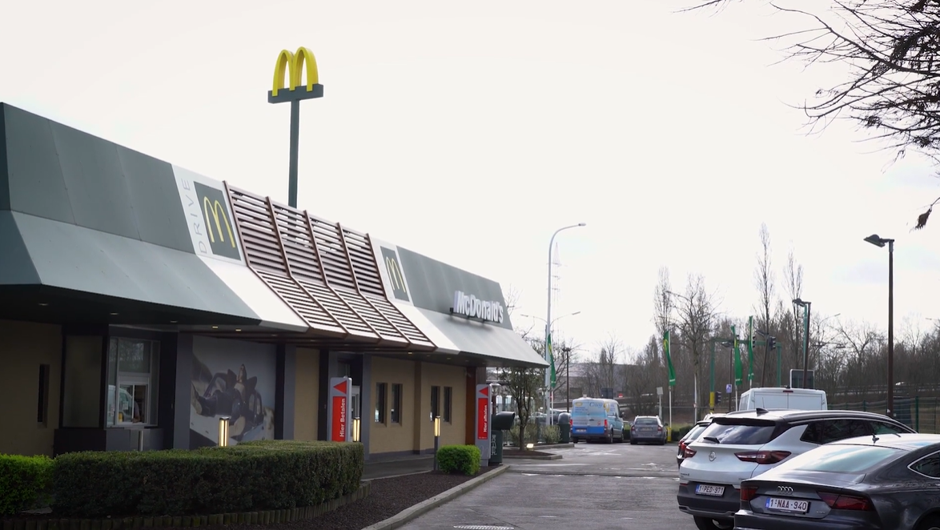

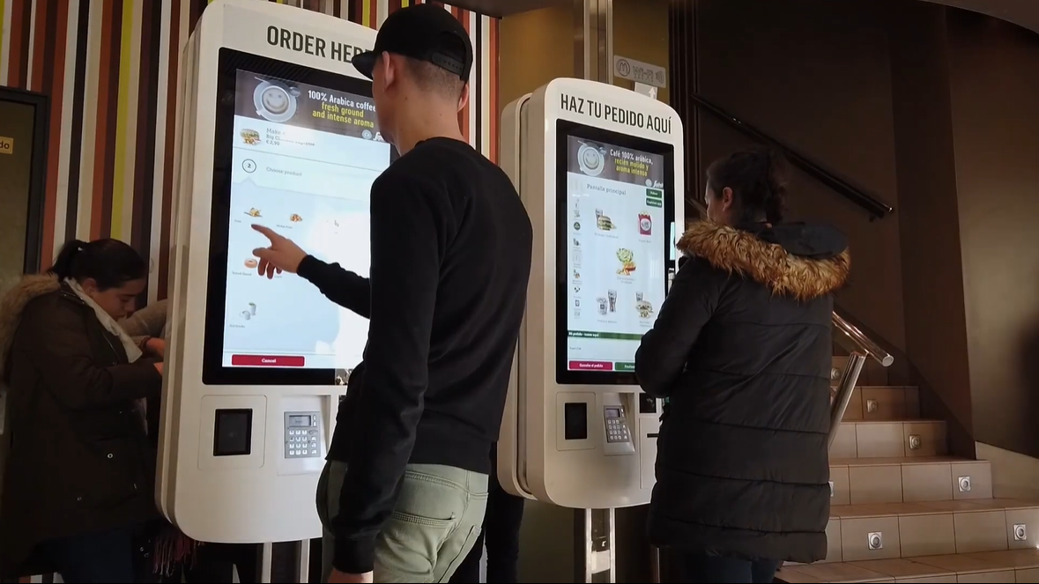

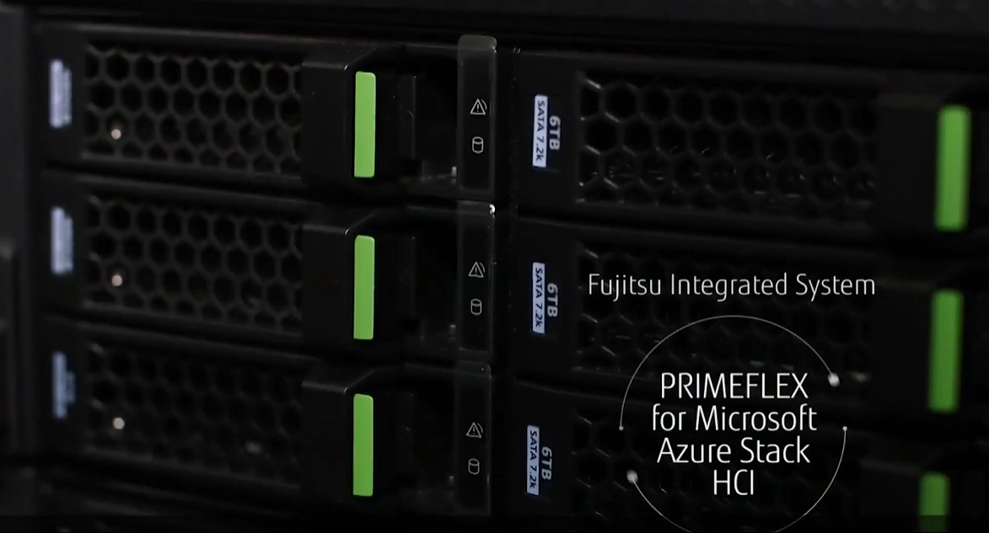

McDonald’s retail kiosks
Simplifying in store ordering and IT
Summary: Kiosk front-end runs Windows 10 Pro for self-service ordering, with back-end on two-node Fujitsu PRIMEFLEX for Microsoft Azure Stack HCI, secured by Azure cloud.
Microsoft Marketing Video:
https://www.youtube.com/watch?v=DS6MWS5BIxs
Notes:
Good example of the strength of Azure Stack HCI in ROBO

Slide 57



Hyperconverged infrastructure and remote learning with Azure Stack HCI and Intel
Business Need
Benenden School needed a hyperconverged infrastructure capable of automatic failover that would keep onsite IT requirements low while facilitating remote learning.
Solution
Benenden worked with Microsoft partner, DataON, who suggested a solution standardized on Microsoft software and pre-validated Intel data server systems. Adopting Azure Stack HCI with Intel hardware, the school gained a highly reliable solution that exceeded its needs and opened the door to a hybrid cloud infrastructure that could reshape the way the school operates for years to come.
“A hyperconverged solution from Microsoft and Intel was perfect for us. It lays the foundation for delivering essential services like virtual infrastructure and remote learning while driving datacenter modernization.”
Andrew France, Systems Administrator and Technical IT Services Delivery Manager, Benenden School
Business Impact
The new infrastructure automatically redistributes workloads based on capacity and coordinates hardware and software updates for less downtime—allowing the school to better serve the changing needs of its international student population.
Read the full case study
Notes:
This case study shows the value of stretched cluster which is integrated in the Azure Stack HCI offering.

Slide 58








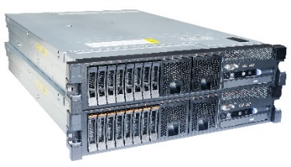
















SKF Digital Manufacturing – “Cloud managed, locally executed”
Azure Stack HCI
Azure Cloud
Virtual machines
IoT Edge
IoT hub
Web Apps
Data factory
Data Collector
Storage
Power BI
Kubernetes
SQL Edge
Arc Data Services
Update Management
Azure Backup
Virtual
machines
Arc enabled Kubernetes
Azure Monitor
Azure Cloud
Security center
Container registry
Key vault
Azure AD
IoT hub
Sentinel
Azure Policy
Log analytics
Defender for IoT
Notes:
Let’s look at the architecture side of things. SKF needed to run their workloads locally due to requirements set by critical production systems but they wanted to manage the environment with the same convenience they get from cloud platforms.
SKF has their Azure Stack hardware standardized to virtually a single catalogue node and can offer T-shirt size options to their factories by controlling the number of nodes. They have the hardware pre-connected with Azure, and pre-configured with Azure hybrid services. They get a lot of deployment speed from this kind of delivery model. SKF needed a solution that can facilitate cost efficient way to managing the workload life-cycle. They have this based on
Azure Kubernetes Service on Azure Cloud and Azure Stack HCI, and
Azure Arc enabled Kubernetes on legacy Hyper-V platforms.
Together with automation tools, SKF can significantly reduce resources required to deliver on workloads and increase at the same time productivity with the developers.
SKF Quote ‘This gives us a tremendous jump start into digitalization.’

Slide 59
Hardware form factors

Slide 60
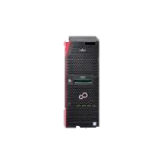
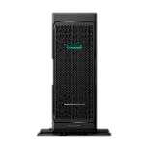
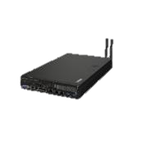
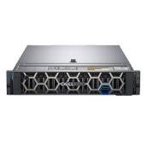
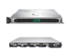

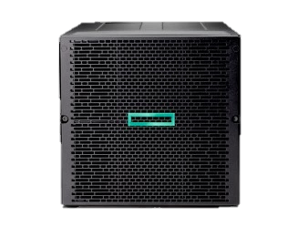
Multiple form factors from various partners for any environment
Remote Office Branch Office
Edge compute scenarios
Datacenter modernization
Workload flexibility
Tower form factor-for no rack environments
Super small footprint for edge scenarios-can be ruggedized
Industry rack mounted servers in various height-for datacenter modernization
Composable architecture and blade server for ultimate in provisioning and workloads flexibility
Notes:
Broad choices of hardware deployment available.

Slide 61
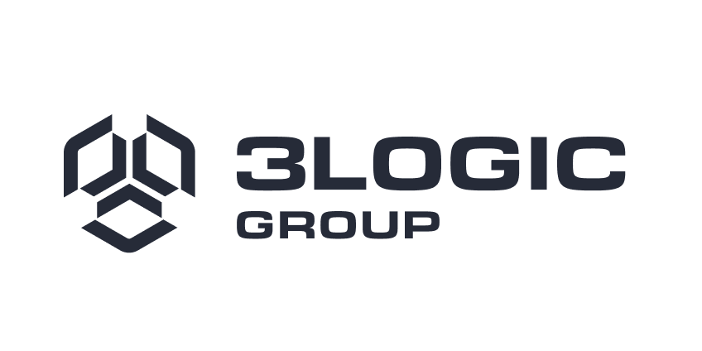



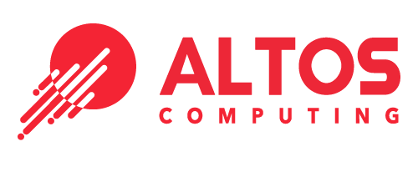
























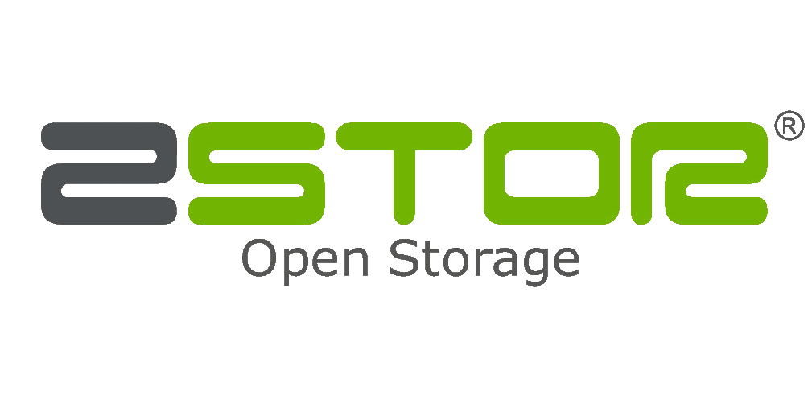



Azure Stack HCI solution partner ecosystem
Visit the Azure Stack HCI Catalog

Slide 62
Licensing

Slide 63
Azure Stack HCI Licensing
Host Subscription | Azure Stack HCI - Leverage software defined datacenter features
Guest License | Windows VMs and Unlimited Linux VMs - Windows VMs monetized via Windows Server License or new Windows Server guest subscription licensing for Azure Stack HCI
Management | Windows Admin Center Azure Arc Other tools possible Arc enabled for at scale management, monitoring
Channels | EA/CSP/Web Direct Price list active dates: CY2021
Pricing Model | Monthly subscription No Cost ESU for Windows Server & SQL Server 2008/R2, Windows Server 2012/R2 & SQL Server 2012 workloads
Subscription List Price | USD$10/physical core/month
Support | Azure/Premier support
Minimum buy-in | 1 core
Trial | 60 days free
Languages | (18) Czech, German, English, Spanish, French, Hungarian, Italian, Japanese, Korean, Dutch, Polish, Portuguese-Brazil, Portuguese-Portugal, Russian, Swedish, Turkish, Chinese-Simplified, and Chinese-Traditional (Taiwan)
Modern subscription for flexible, hybrid hyperconverged infrastructure
Create Azure affinity: customers can only purchase via modern Azure channels
“Always up-to-date” product that requires Azure connectivity
Offers flexibility to add commitment-based offers in future

Slide 64
Always up-to-date subscription
Yearly major releases planned for 2020, 2021, 2022, and beyond
Azure Stack HCI,
version 20H2
Azure Stack HCI,
version 21H1
Azure Stack HCI,
version 21H2
Azure Stack HCI,
version 22H1
Azure Stack HCI,
version 22H2
2020
2021
2022
Subscription business model = customers are always entitled to updates
Update cadence:
Monthly security and quality updates, on the same “Patch Tuesday” timeline as Windows proper
Occasionally, once or twice per year, the monthly update will be what’s called a “Feature Update” with new features
OEM firmware/driver packages are typically available quarterly
Notes:
Since Azure Stack HCI is available as a subscription…you keep accumulating new features.

Slide 65


What does Azure Stack HCI charge for?
Cores
80
70
60
50
40
30
20
10
Cores from running virtual machines
USD $10/month
per physical processor core*
Physical cores
*Does not include Guest OS licensing
0 1 2 3 4 5 6 7 8 9 10 11 12 13 14 15 16 17 18 19 20 21 22 23 24 25 26 27 28 29 30
Days
Predictable
Doesn’t vary with consumption, more VMs doesn’t cost more
Simple
No math with memory, storage, or network ingress/egress
Efficient
Virtualize efficiently, with higher v-to-p density

Slide 66






Costs scale predictably from edge to datacenter
Example of scale based on actual offering – not reflective of all OEM solutions
PRIMERGY TX1330 M4
4 cores
Cost per server
$40 /month
ThinkAgile MX1021
8 cores
Cost per server
$80 /month
Integrated System AX-640
16 cores
Cost per server
$160 /month
ProLiant DL 380 Gen 10
24 cores
Cost per server
$240 /month
No minimum or maximum
(starts from 1 core for 1 day)

Slide 67

How it works: License guests and apps separately
Azure Stack HCI delivers simplicity and flexibility for licensing – learn more aka.ms/azurestackhcipricing
What you want to run:
Linux applications
Open-source software
What you want to run:
A few Windows Server roles or applications persistent licensing
What you want to run:
Unlimited Windows Server roles or applications persistent licensing
What you want to run:
Unlimited Windows Server roles or applications
guest subscription licensing
What you buy:
OEM HW
+
Azure Stack HCI
Nothing else from Microsoft
See provider if fees apply
What you buy:
Validated OEM HW
+
Azure Stack HCI
+
Windows Server 2022 Standard(s)
What you buy:
Validated OEM HW
+
Azure Stack HCI
+
Windows Server 2022 Datacenter
What you buy:
Validated OEM HW
+
Azure Stack HCI
+
NEW Windows Server subscription guest licensing
Host Subscription
Guest:
Perpetual or subscription
Notes:
Reminder: Azure Stack HCI does not include the cost of the guest license…just like any of the other HCI platforms. For Azure Stack HCI as a host, there is now Windows Server guest licensing subscription available.

Slide 68

Azure Stack HCI – In Summary
VM, Containers, & Azure Cloud Services On-Premises
Maximize performance
Native Azure Integration
Solution scales down to 2 nodes and can be “switchless”
Integrated Full Stack Updates
Industry leading HCI performance*
Native DR with Stretch Clustering
ESUs included at no cost
1M IOPS / SERVER
Random 4k storage I/O per second from virtual machines
“the fastest we’ve seen in a mid-market 4-node HCI cluster”
- StorageReview.com
*publicly demonstrated over 13.7 million IOPs from a 12-node cluster. No other HCI vendor has demonstrated half this performance.
Notes:
The new HCI industry record: 13.7 million IOPS with Windows Server 2019 and Intel® Optane™ DC persistent memory - Microsoft Tech Community

Slide 69
How to try Azure Stack HCI
Buy a validated hardware solution from a trusted partner or check with your solution provider if existing hardware can be supported
Install Azure Stack HCI software with a free 60-day trial
AND
Browse solutions
Download software
Please note:
1. An Azure subscription is required to complete the full set-up on your server hardware
2. Integrated systems (and some validated nodes) come with Azure Stack HCI software pre-installed

Slide 70



Microsoft Learning Paths
Learn new skills and discover the power of Azure Stack HCI with step-by-step guidance
Azure Stack HCI Foundations
Operate and Maintain Azure Stack HCI
NEW Advanced learn modules for administrators
Modules:
Introduction to Azure Stack
Introduction to Azure Stack HCI core technologies
Plan and deploy Azure Stack HCI
Integrate Azure Arc and Azure Stack HCI
Modules:
Manage Azure Stack HCI clusters
Integrate Azure services with Azure Stack HCI
Manage Azure Stack HCI virtual machine workloads
Manage Azure Kubernetes Service on Azure Stack HCI
Modules:
Implement Datacenter Firewall and Software Load Balancer on Azure Stack HCI
Plan for and deploy SDN infrastructure on Azure Stack HCI
Notes:
Azure Stack HCI learning paths for customers and IT pro/admins who want to dig more in product knowledge.

Slide 71
Resources
Read
Azure Stack HCI Product Page azure.com/hci
Latest feature update for Azure Stack HCI Whitepaper aka.ms/azurestackhci2021updatewp
Datacenter Modernization Whitepaper aka.ms/datacentermodernizationwp
Technical Use Cases Whitepaper aka.ms/technicalusecaseswp
Hybrid Cloud Essentials Whitepaper aka.ms/hybridcloudessentials
ESG Analyst Report aka.ms/esgtechnicalvalidation
Case Studies Benenden School Bradley SKF
Watch
Discover the new Azure Stack HCI aka.ms/discoverazurestackhci
Product tour of the new Azure Stack HCI using WAC aka.ms/deployhciwithwac
Disaster Recovery with Stretch Clustering aka.ms/stretchclustervideo
Technical roadmap feature videos Kernel Soft Reboot Every Node Arc-Enabled Intent Driven Networking GPU Management Multi-cluster Monitoring Automatic Virtual Machine Activation
Do
Get started with the Azure Stack HCI Trial aka.ms/evaluate-hci
Visit Tech Docs to see how it all works aka.ms/hci-docs
Visit the Azure Stack HCI Catalog aka.ms/azurestackhcicatalog
Get training:
Azure Stack HCI foundations - Learn | Microsoft Docs
Operate and maintain Azure Stack HCI - Learn | Microsoft Docs

Slide 72

Thank you!

Slide 73
Appendix

Slide 74
Notes to reader
Appendix slides are NOT customer facing.
These appendix slides have been provided for Microsoft and partner presenter internal education only.
Use the information if questions arise on these topics but do not show these slides to customers.
Please Note: Microsoft Confidential and information on these slides are subject to change.

Slide 75

How to compare against VMware licensing
At minimum you need to license two VMware products (and arguably others too)
Ignore costly mandatory support contract
Choose middle SKUs because entry-level ones are missing key features
vSphere
Hypervisor¹
vSAN
Storage²
Standard
$995
per processor
Enterprise Plus
$3,595
per processor
Platinum
$5,395
per processor
Standard
$2,495
per processor
Advanced
$3,995
per processor
Enterprise
$5,495
per processor
Standard edition is missing encryption, load balancing, proactive high availability, SR-IOV, persistent memory, and more ³
Standard edition is missing encryption, stretched cluster, deduplication and compression, erasure coding, and more ⁴
¹ https://www.vmware.com/reusable_content/vsphere_pricing.html
² https://www.networkworld.com/article/3243579/review-vmware-s-vsan-6-6.html
³ https://www.vmware.com/content/dam/digitalmarketing/vmware/en/pdf/vsphere/vmw-flyr-comparevsphereeditions-uslet.pdf
⁴ https://www.vmware.com/content/dam/digitalmarketing/vmware/en/pdf/products/vsan/vmware-vsan-67-licensing-guide.pdf
Microsoft Confidential

Slide 76
Better value for the money with Azure Stack HCI
Compare:
Compare:
single-socket 8-core edge server for 3 years
dual-socket 24-core server for 3 years
Azure Stack HCI
includes compute, storage, networking
VMware ¹
vSphere Enterprise Plus + vSAN Advanced
Azure Stack HCI
includes compute, storage, networking
VMware ¹
vSphere Enterprise Plus + vSAN Advanced
$2.9K
/server
vs
$7.6K
/server
$8.6K
/server
vs
$15.2K
/server
+162%
+77%
Pure software stack list price comparison
Excludes hardware, support, guests
¹ VMware cost assumes the middle SKU of vSphere and vSAN, which excludes key features, and does not include VMware NSX, meaning no software-defined networking.
Microsoft Confidential

